Slide 1
Gro Gro
The smarter, health conscious, grocery list
Notes:
Peter
Grocery list app
Store lists and get nutrition information about your grocery list

Slide 2
Team 1
Jessie Sodolo - Front End
Rob Russo - Front End
Sarah Abrahamson - Back End
Peter Ryder - Back End
Notes:
Peter

Slide 3
Project Description
A smarter, health conscious, grocery list
Provide useful analytics on shopping lists
Protein, Energy, Fat, Carbohydrate, Fiber and Total Sugar per 100 gram
Create a mobile-ready web app
Create an open RESTful API
Notes:
Jesse

Slide 4
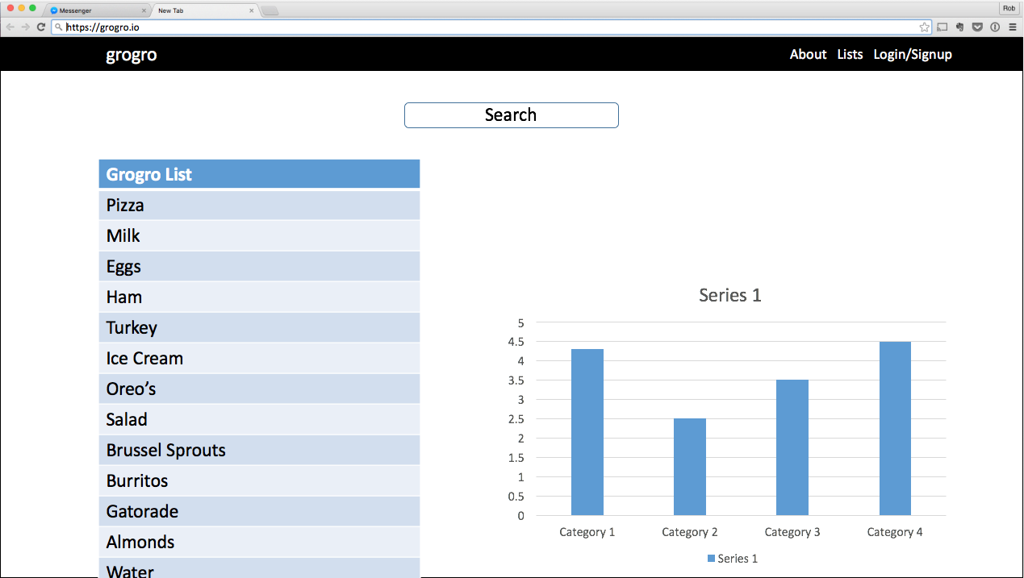
Wireframes/Mockups
Notes:
Jesse
Initial idea, users would add to their grocery list and a chart would display on the same page. We decided to implement a design that resembled a single page layout

Slide 5
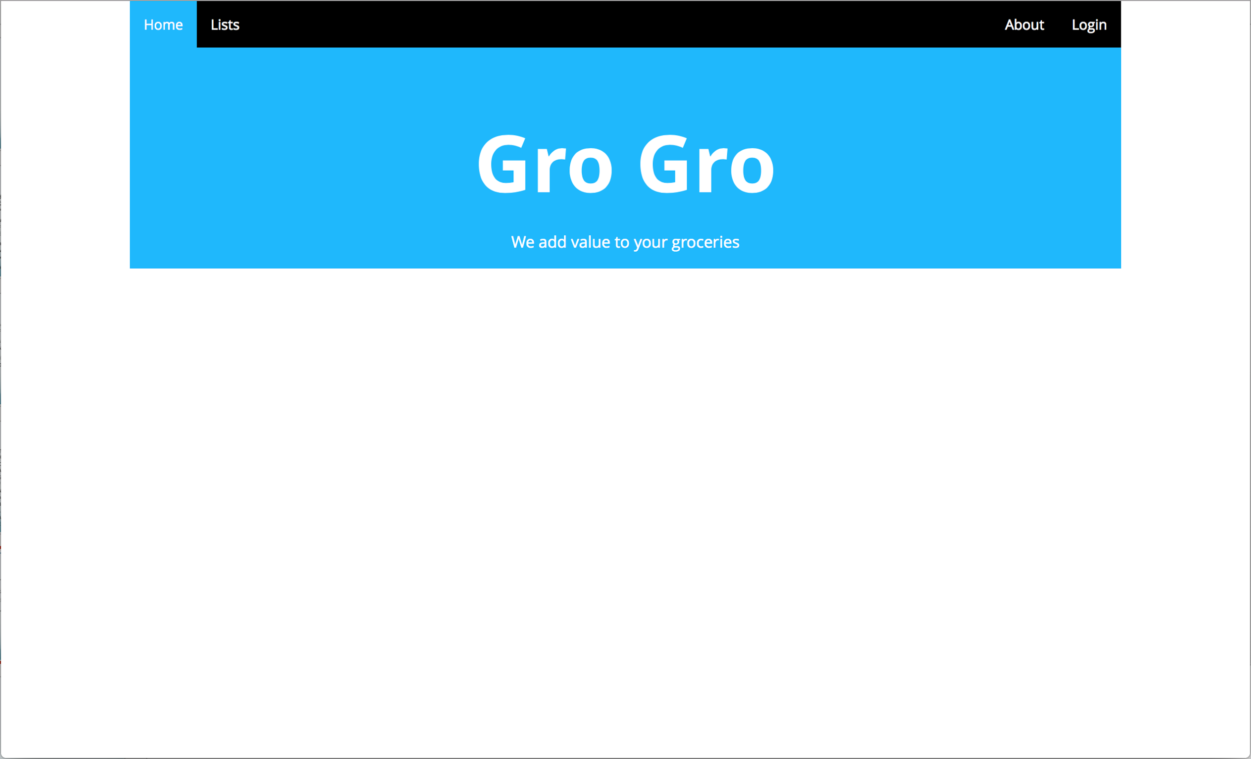
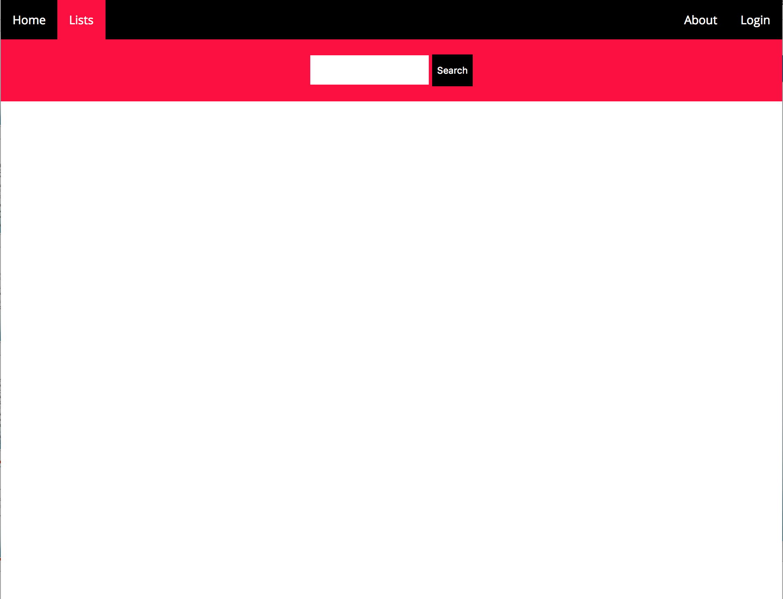
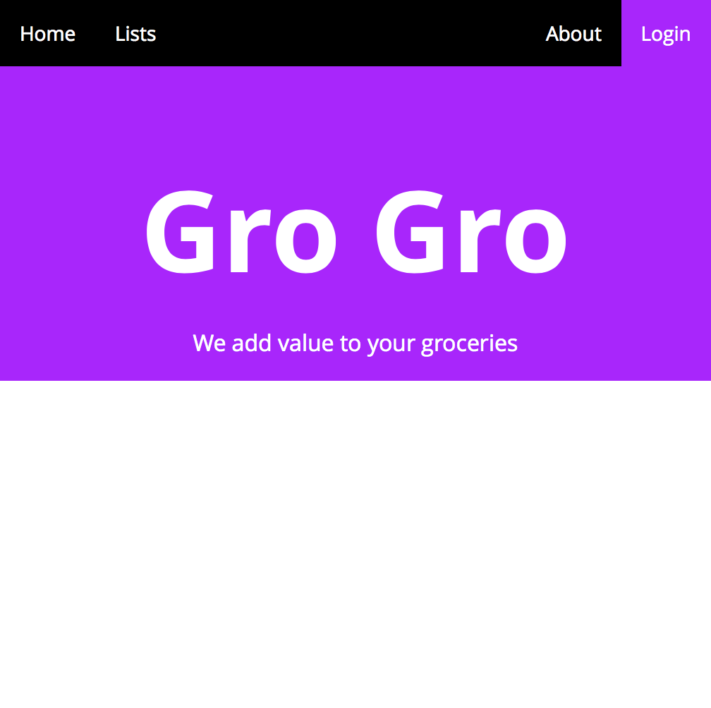
Architecture
Node, Express
Angular, Jade, SASS
MongoDB
Github, Travis CI, Heroku
Facebook, USDA
Notes:
Rob
GroGro utilizes continuous integration and deployment techniques in its development. The backend is, unsurprisingly, usings Node and Express. The front end architecture utilizes Angular to create a single page application. We use routing on the front end and a special route on the back end to render Jade templates into the DOM. SASS is our CSS preprocessor, which makes these themed pages easier to create. We are planning to use MongoDB for our database because of the structure of our data going in and coming out of the application.

Slide 6
Progress
Completed
Single Page Architecture
Continuous Integration Pipeline
Initial Styling
Initial USDA API Implementation
Utilizing Issue Tracking on Github
Not Finished
Database API
User Authentication w/ Facebook
Graphing
Notes:
Rob & Sarah

Slide 7
Demo

Slide 8
Thank You
Questions?

